Slide 1
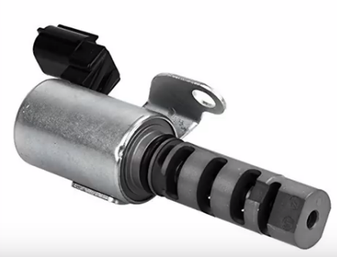
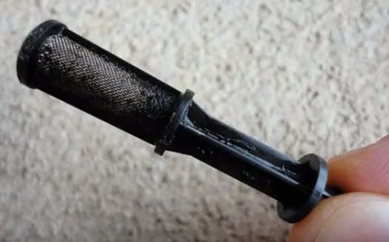
Variable Valve Timing or Variable
camshaft timing oil control valve
Stuck in the open position.
Possible oil blockage from a dirty
Variable valve timing or variable
Camshaft timing filter screen

