Slide 1
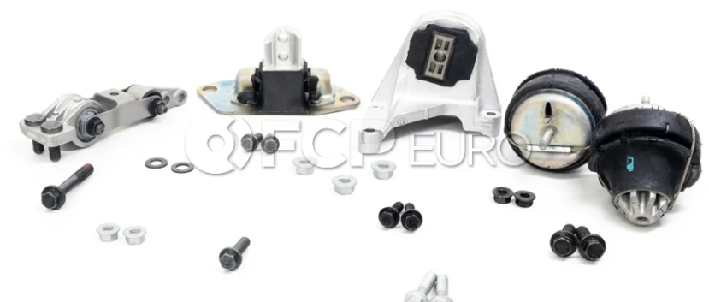
I replaced this one
Which of the other four (4) mounts have some sort of fluid in them?

