Slide 1
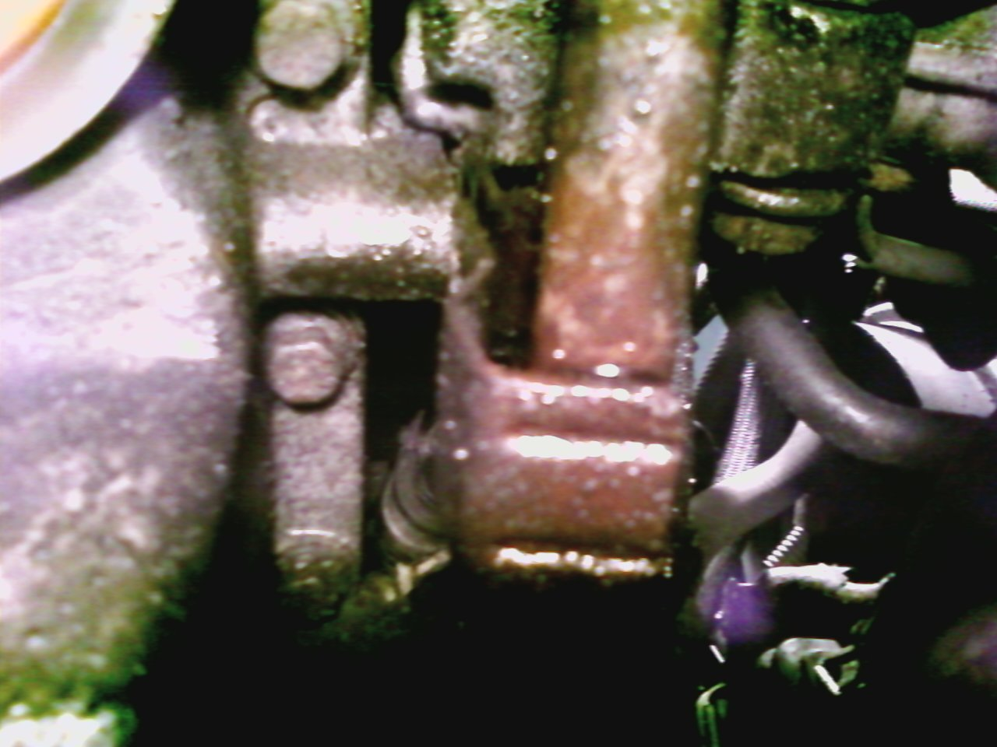
Notes:
This shows the bracket (blue) and part of the metal end of one of the lines (red) the bolt is removed (green)

Slide 2
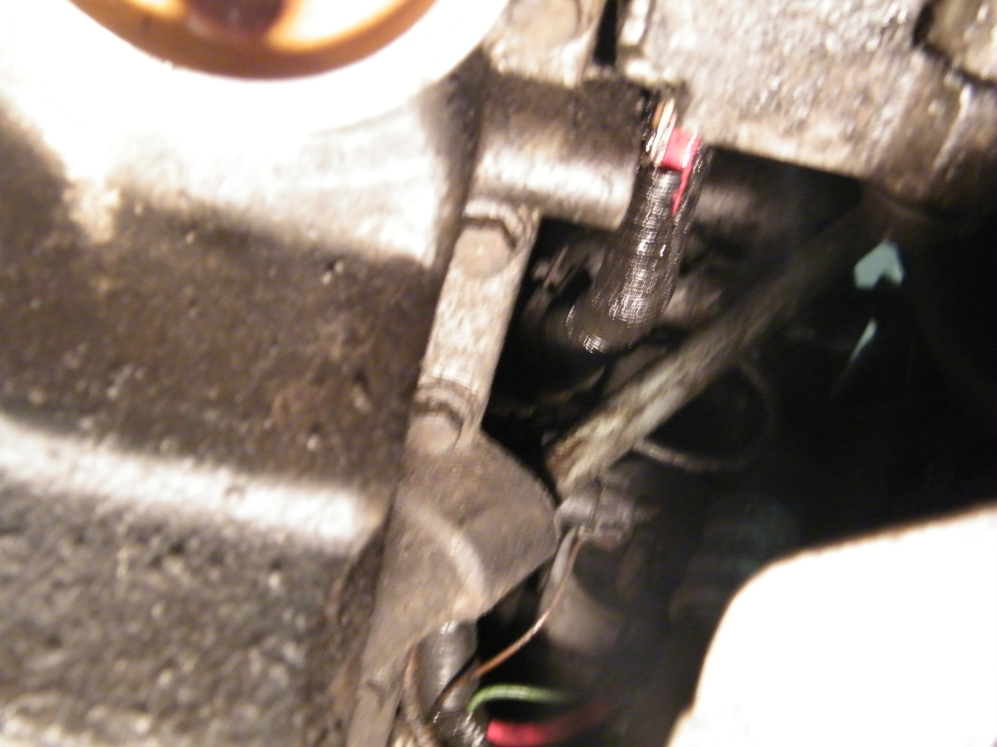
Notes:
This is where I started. This is the bolt hole for the brackets (removed) that mount the lines to the engine. This is the hardest part of the job. You have to go up over top of a cross member with a ¼ extension a wiggle attachment and a 10mm socket. It’s just one of those bolts that takes time to get out.

Slide 3
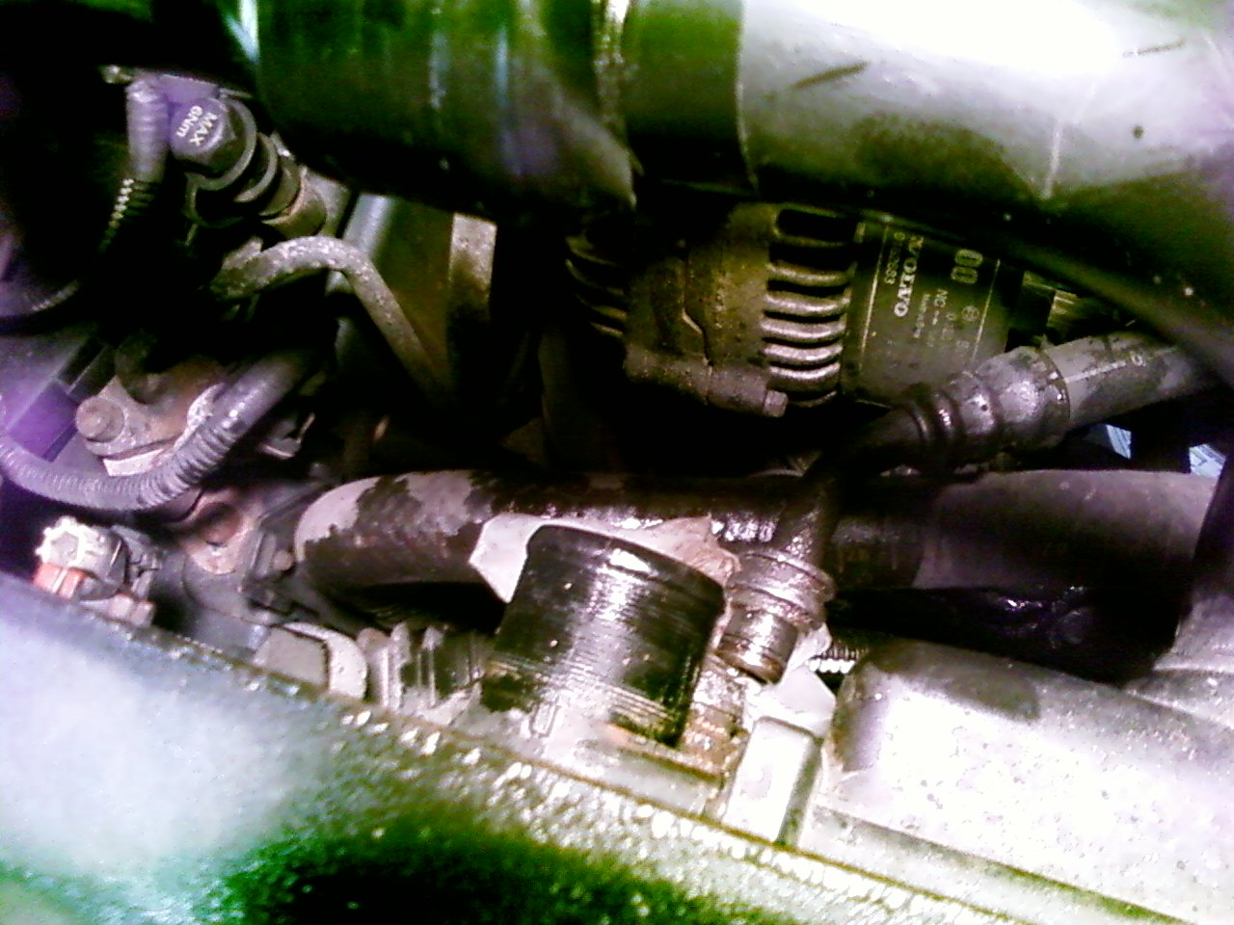
Notes:
Then I took the top radiator hose and oil line off but when I moved to disconnect the bottom line and the thermostat I had to contend with drips of antifreeze and oil so you may want to save the top for last.

Slide 4
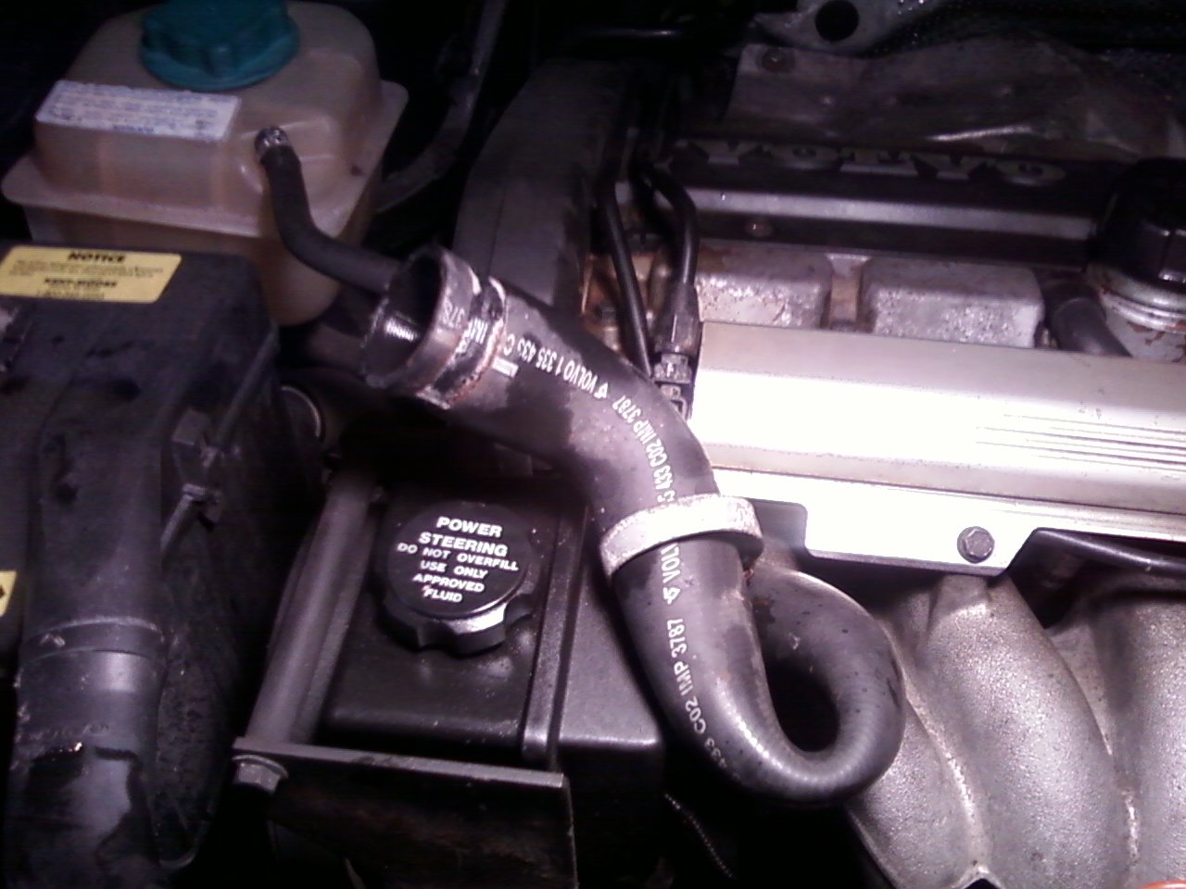
Notes:
Tuck this radiator hose out of the way.

Slide 5
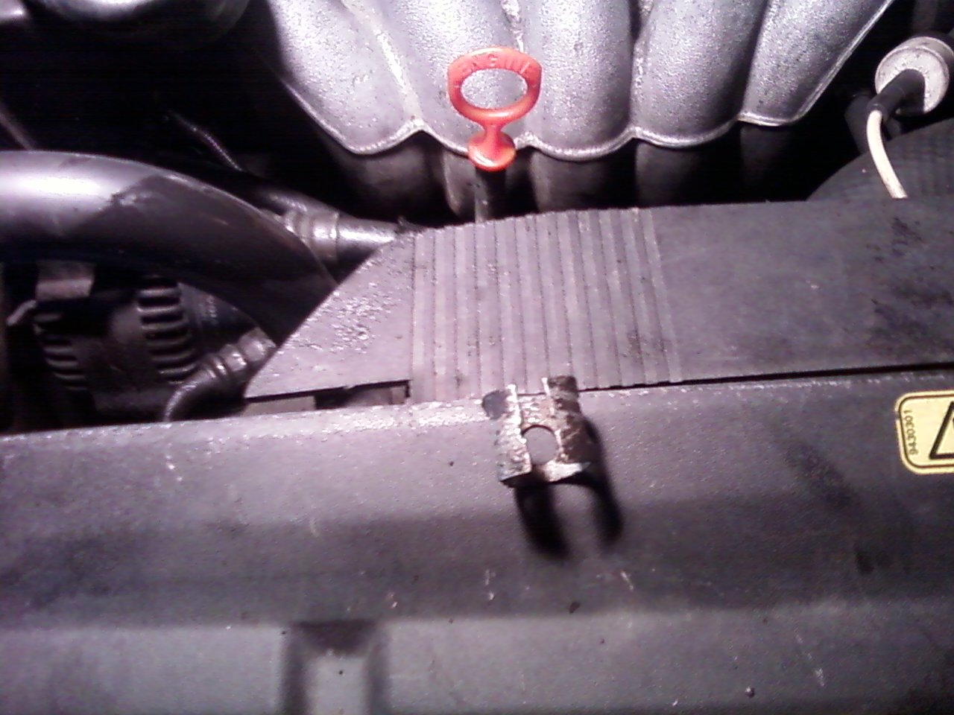
Notes:
This is the clamp that holds the line to the radiator. I put a flat screwdriver to both sides of it and pushed it apart. Watch you don’t slip and push a hole through the radiator. No I didn’t, There is another one for the bottom line too.

Slide 6
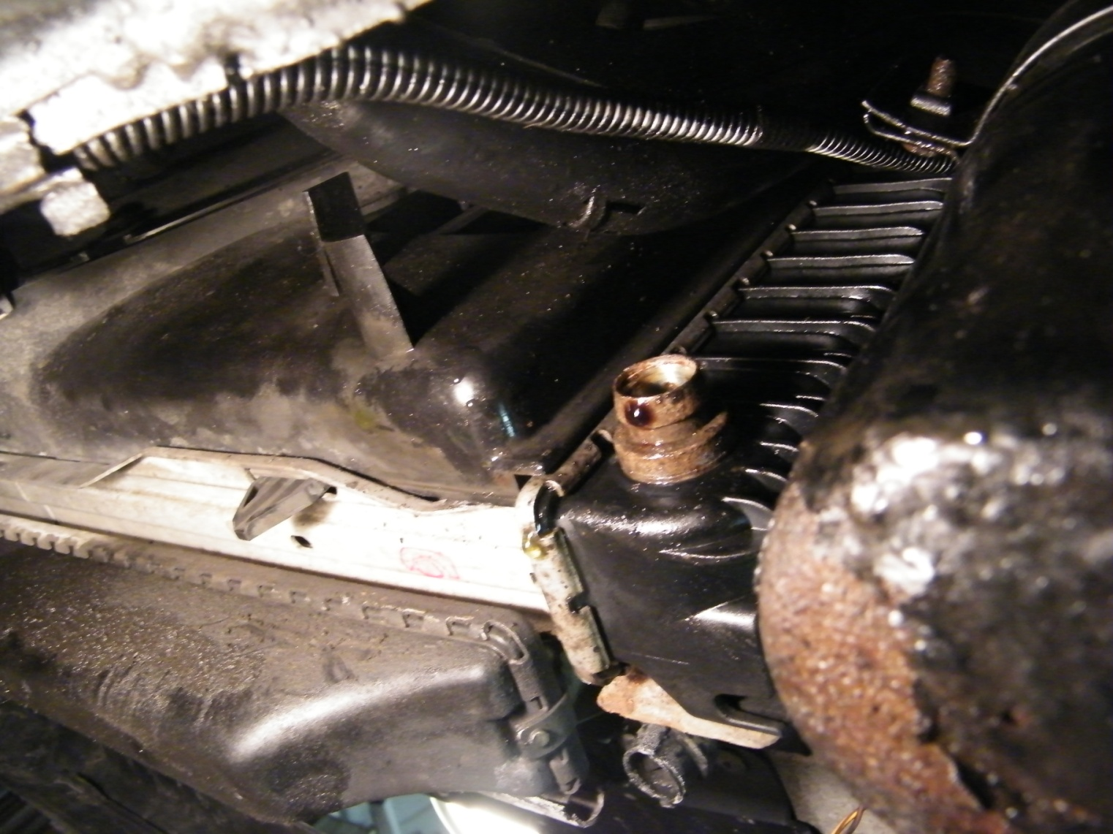
Notes:
Then I took this clamp off. This is the bottom of the radiator with oil line removed

Slide 7
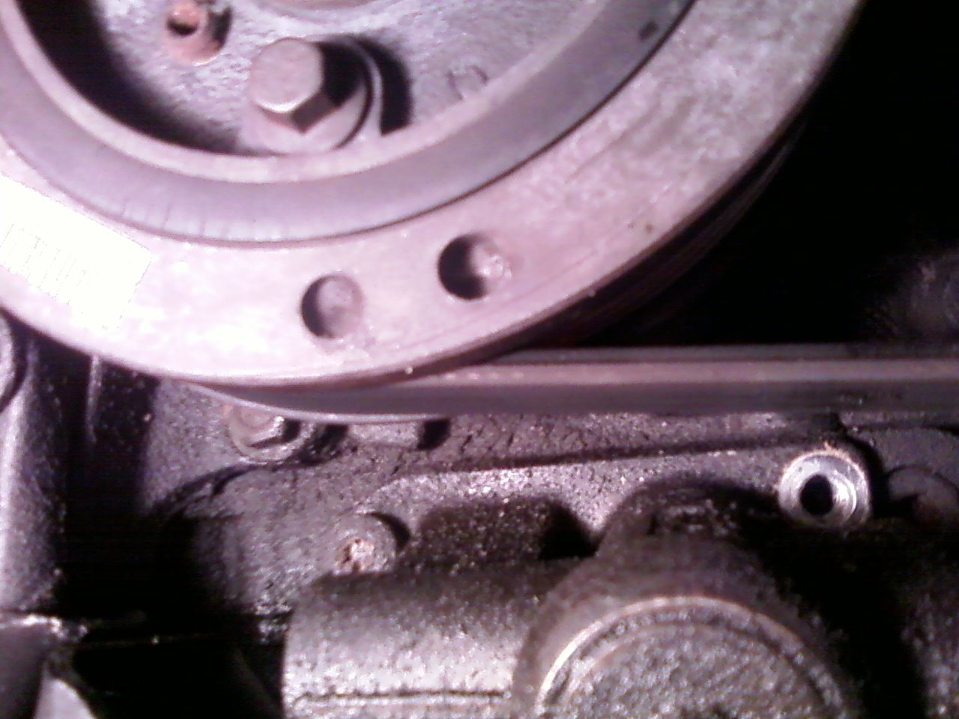
Notes:
Then I disconnected the thermostat. There are 2 torx 40 bolts on the thermostat. Here the right one is removed.

Slide 8
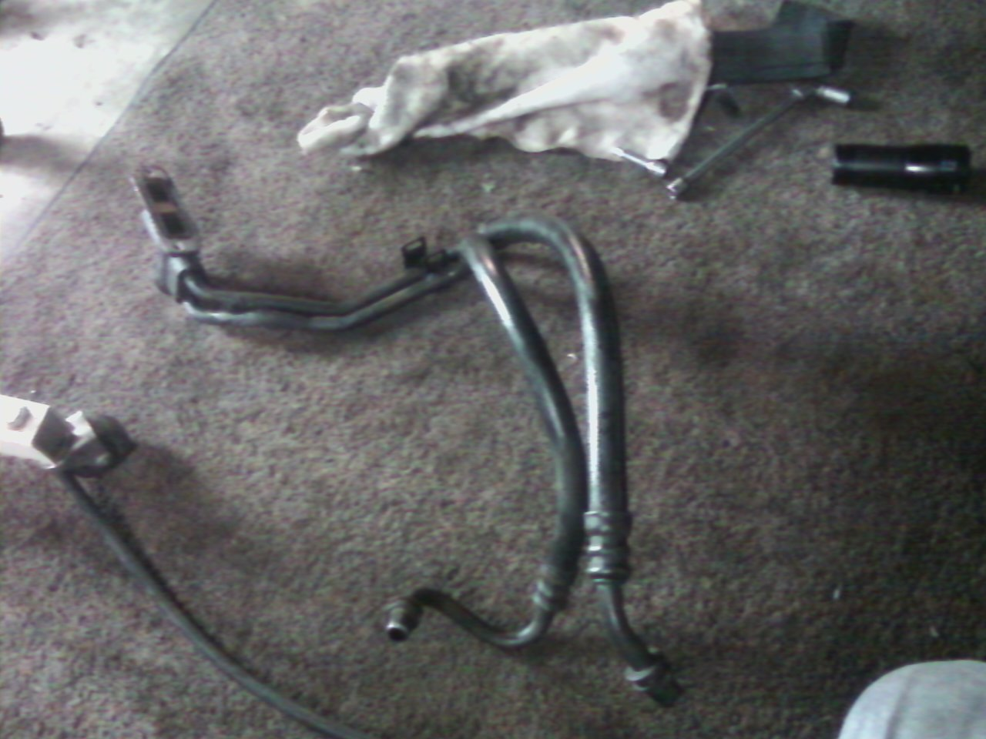
Notes:
Once disconnected I took the whole assembly out together. Each line has its own bracket welded to it. It’s easier if you have someone work the line from the top while you wiggle and slide the assembly out the bottom.

Slide 9
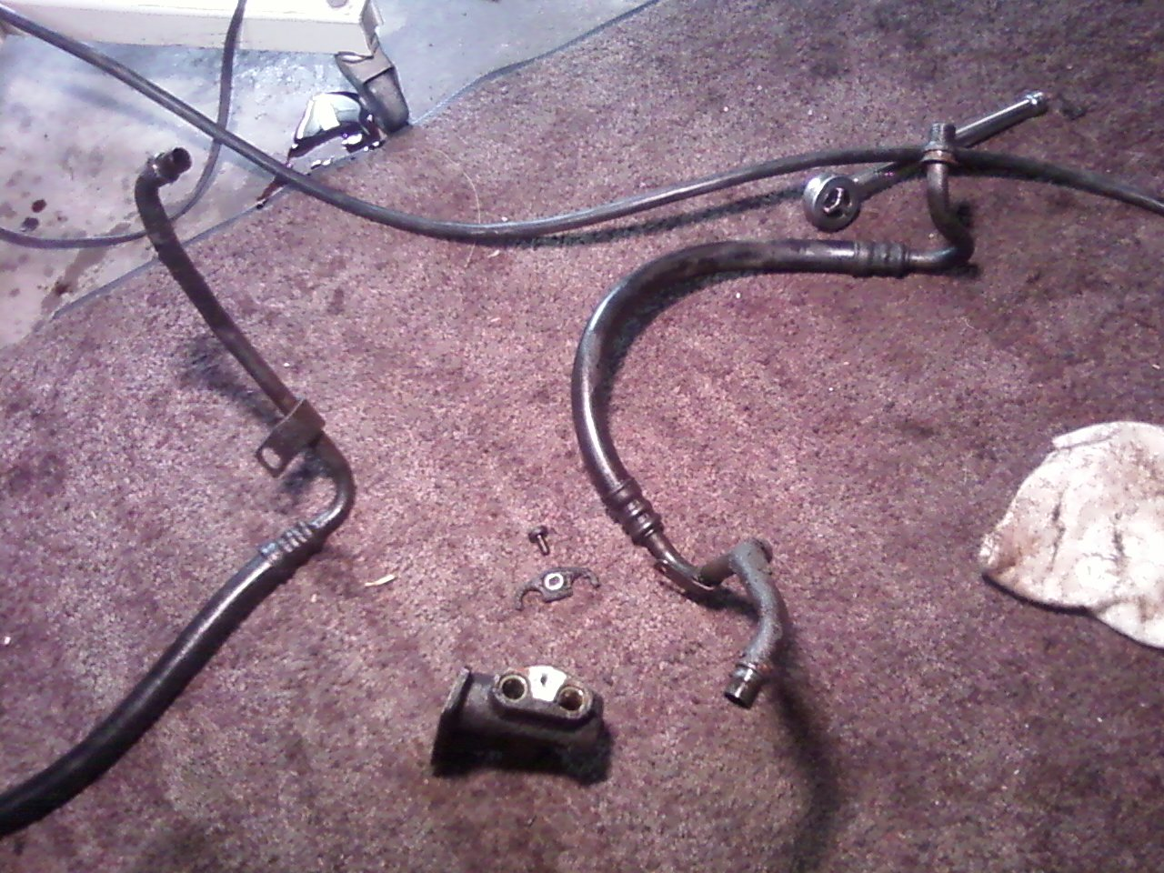
Notes:
There is one torx bolt with a bracket that holds the lines to the thermostat. Yellow arrow. You can disconnect this easily rather then take the whole thing out together

Slide 10
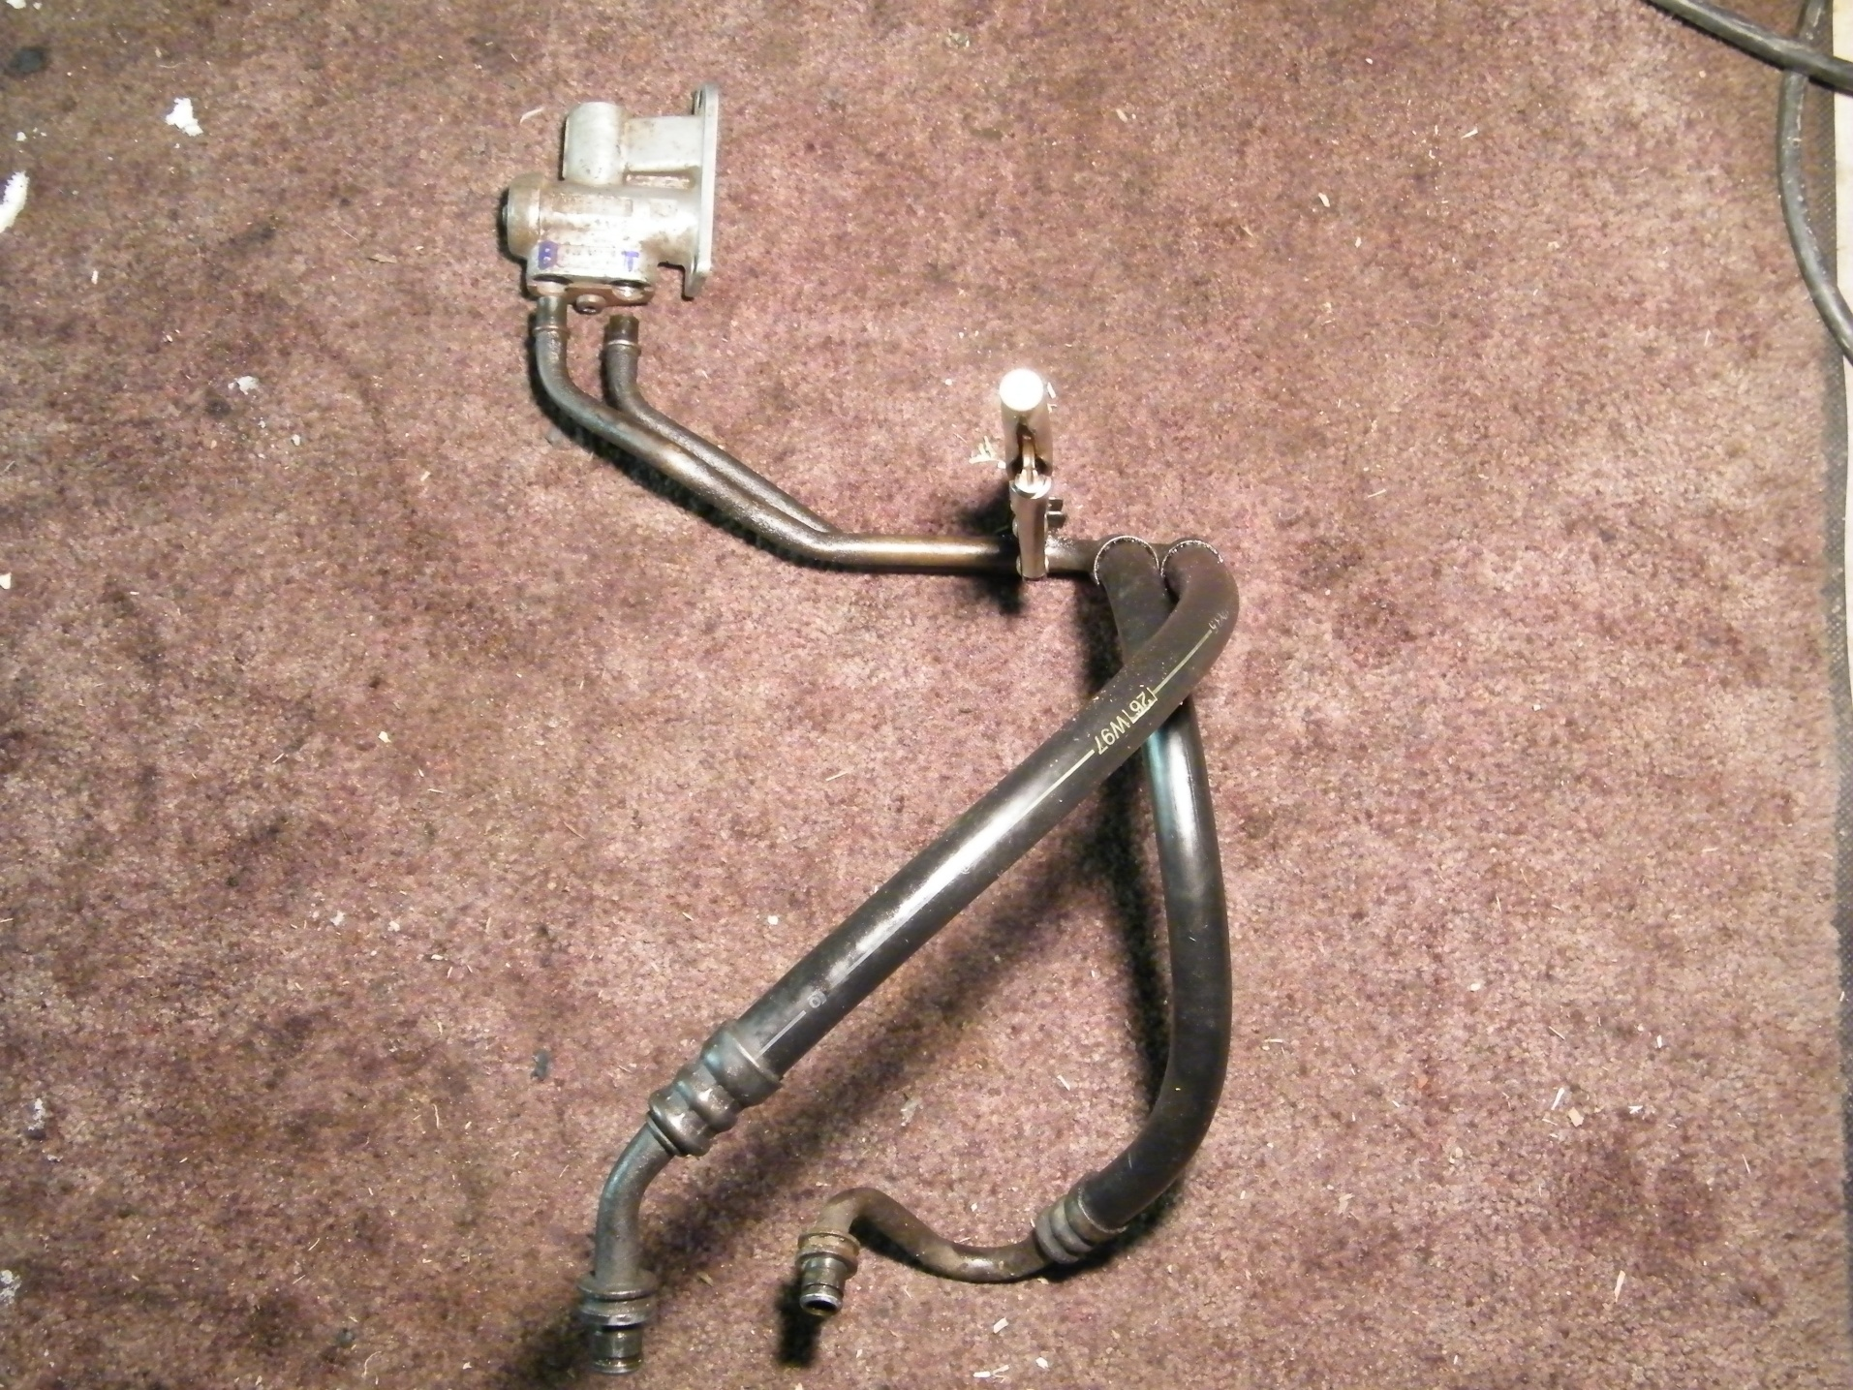
Mounts to car
Mounts to car
Mounts to bottom of radiator
Notes:
That’s how it would look together outside the car. The vice grip (arrow)is where the brackets mount to the car.

Slide 11
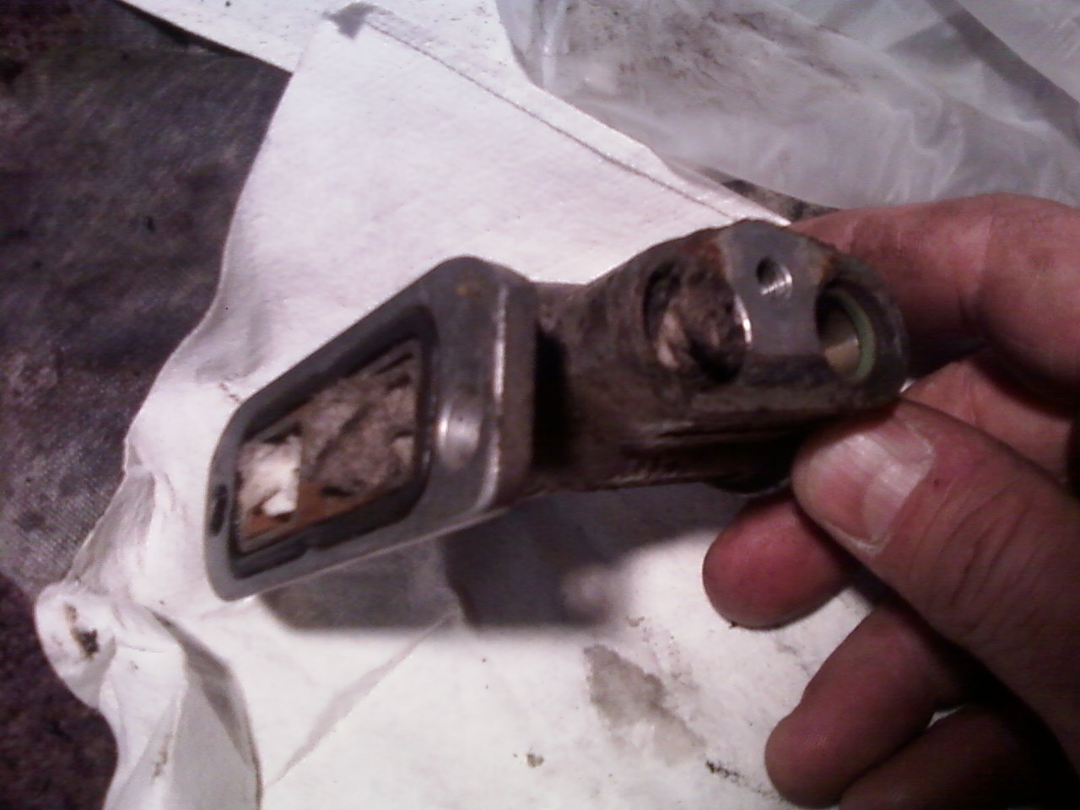
Notes:
I stuffed some rags in the thermostat holes before I cleaned it. This black rectangular gasket I couldn’t find but at the dealer. It was held in there with RTV or something similar. I also read a post someone said that you didn’t really need to replace it.

