Slide 1
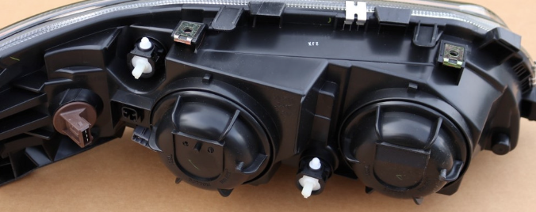
Are these the only two spots where the headlamp is adjusted?

